Slide 1
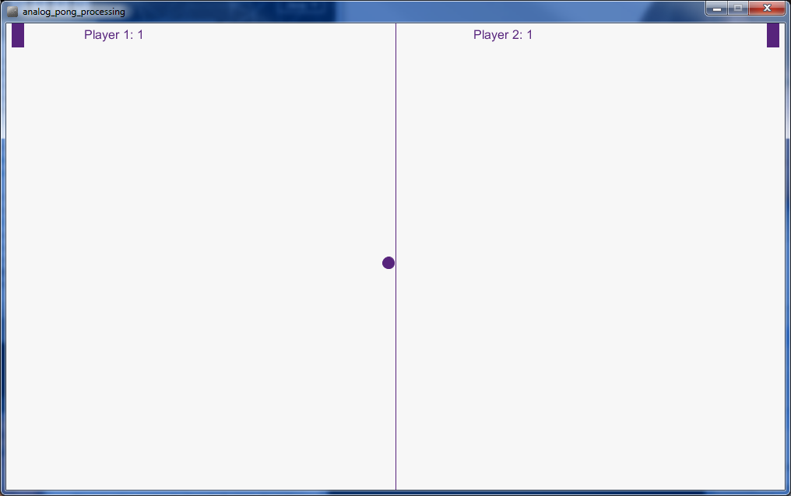
Pong project shows how Galileo can be used to interface with Processing (an IDE to build
interactive graphics with JAVA easily and quickly)
Pong/
analog_pong_arduino/analog_pong_arduino.ino
analog_pong_processing /analog_pong_processing.pde –
* You will need to download Processing to run the Processing sketch.
Processing can be downloaded here: https://processing.org/download/?processing
Tested with Galileo Gen1/Gen2 and Processing 2.2.1 on windows 64-bit
Arduino IDE: File-> Open location of analog_pong_arduino.ino; Upload
Processing IDE: File -> Open location of analog_pong_arduino.pde; File -> Upload

Slide 2
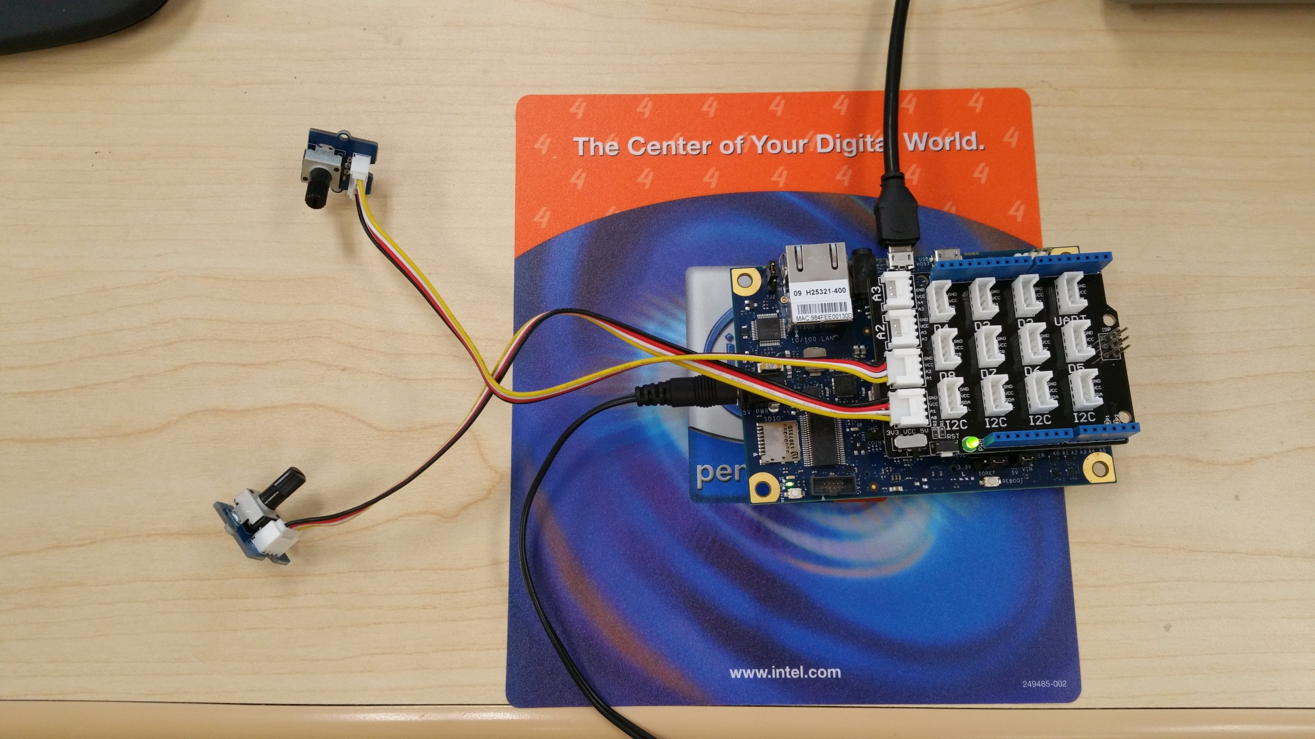
Grove Shield Implementation
Install shield
Plug potentiometer to A0
Plug potentiometer to A1

Slide 3
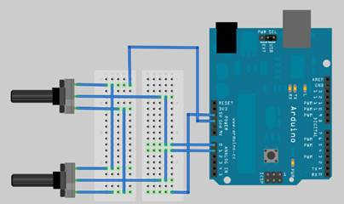
Alternate breadboard implementation

Slide 4
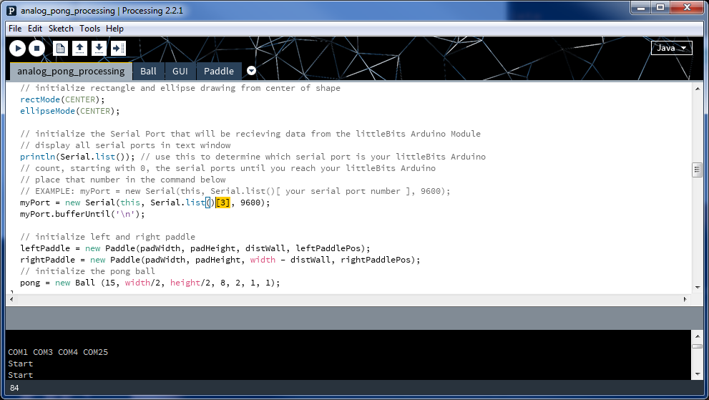
To set COM25 as serial port for processing:
in code use N-1 where N in this example is 4: N-1= (4-1)= 3

